Slide 1
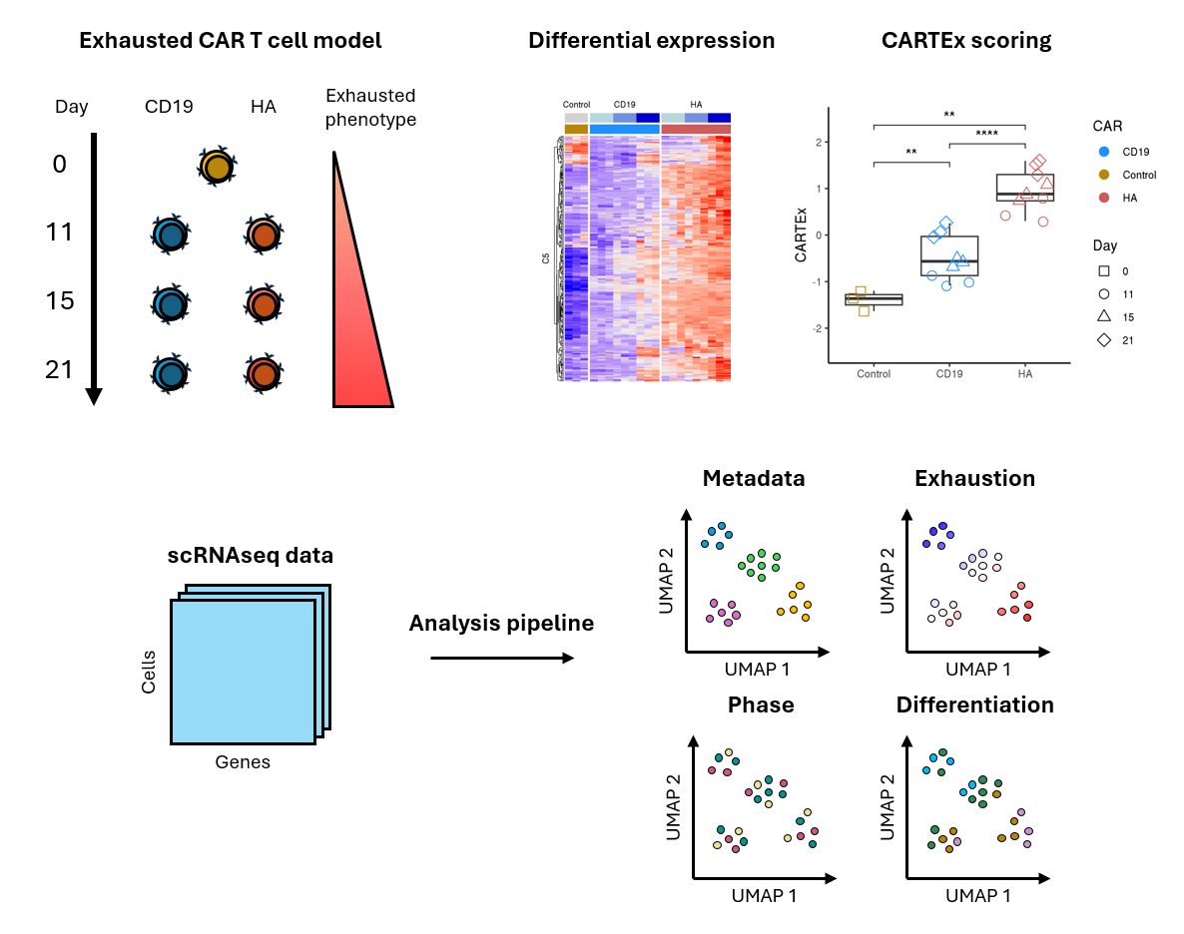
CARTEx project
Graphical abstract

Slide 2
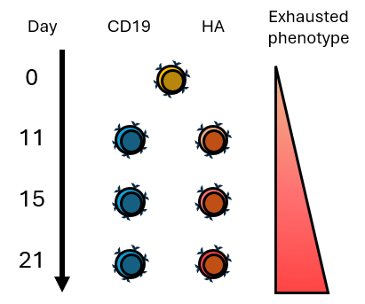
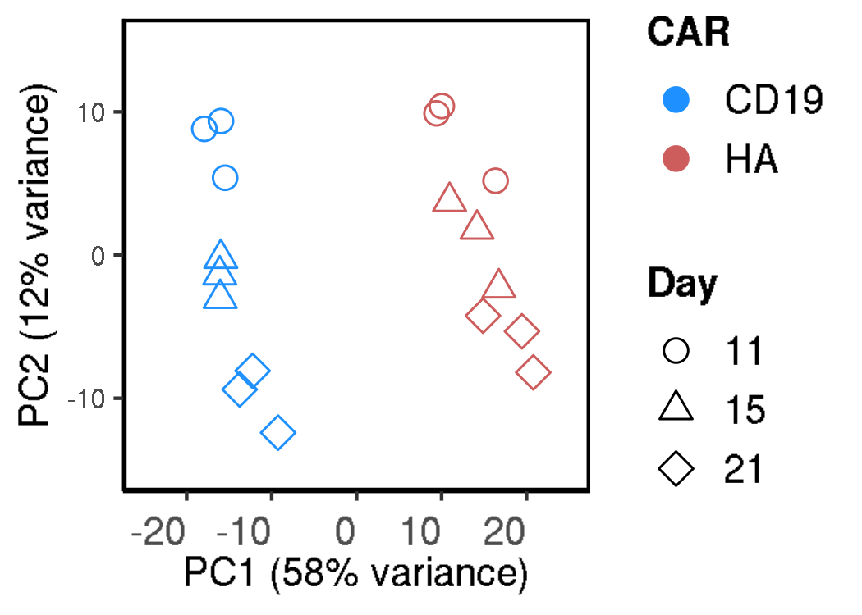
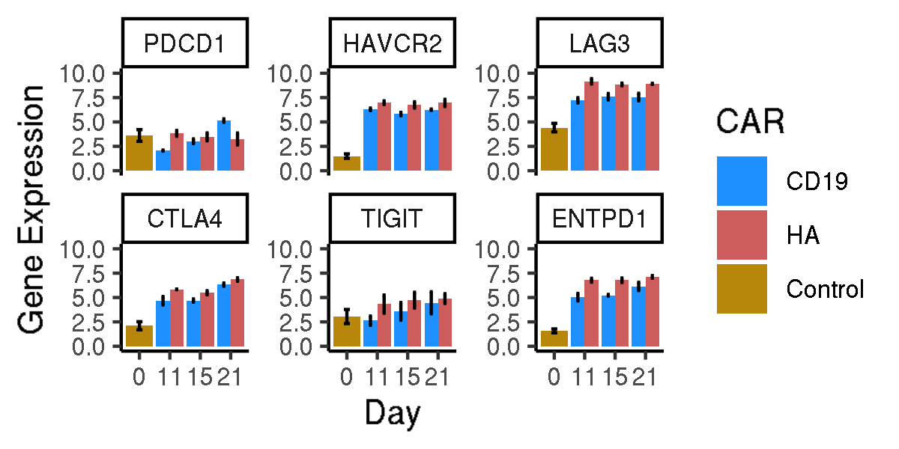
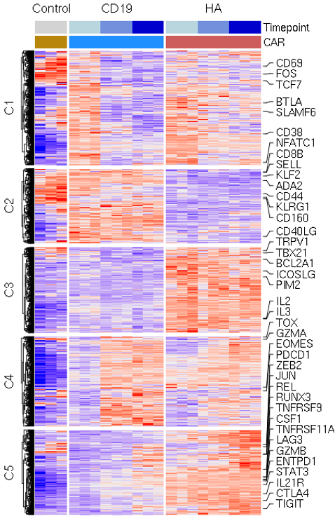
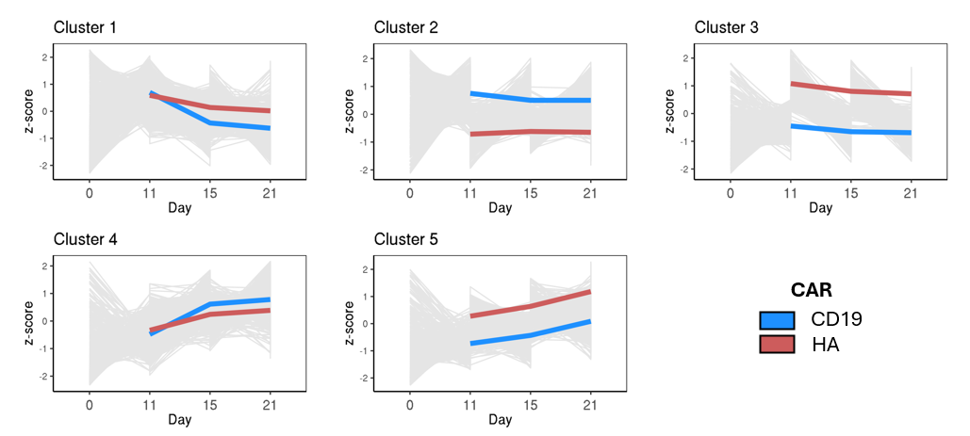
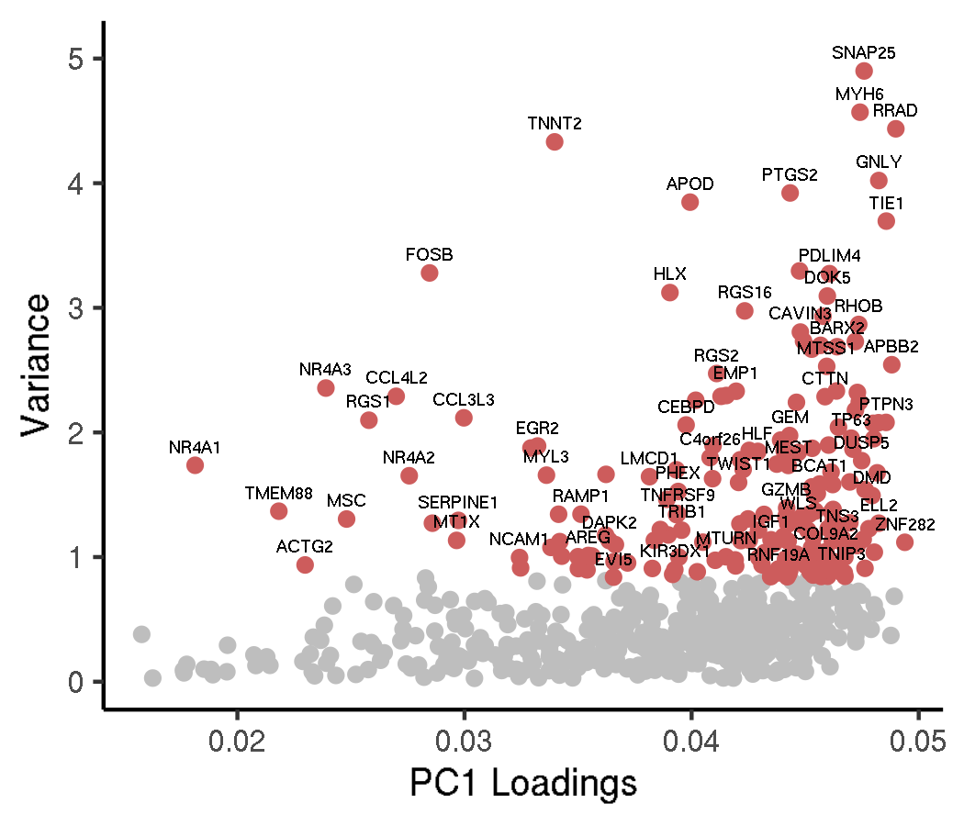
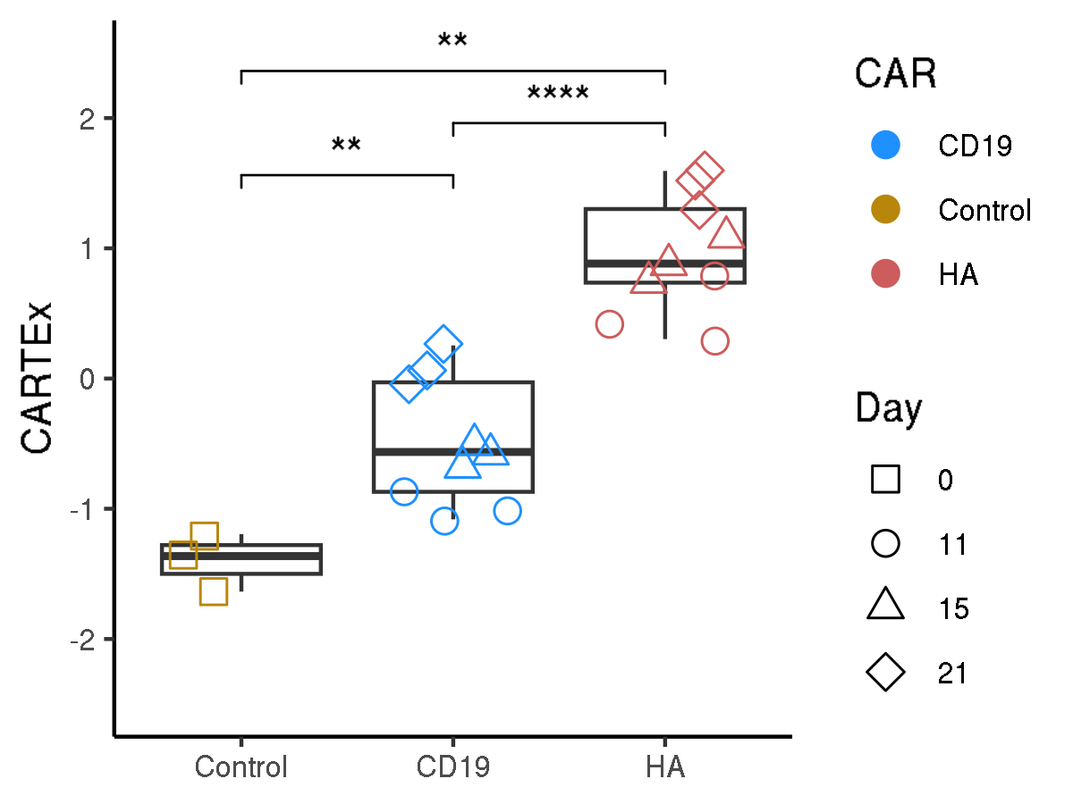
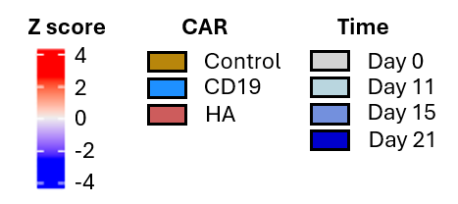
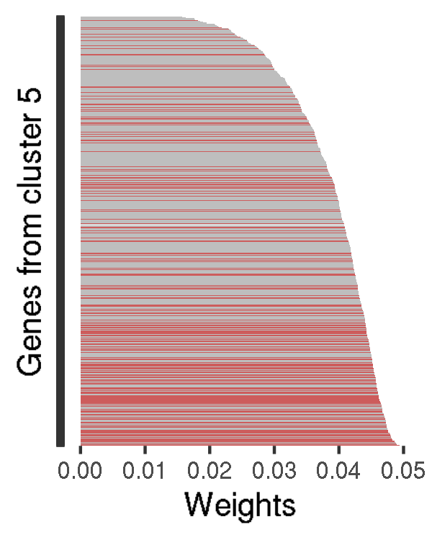
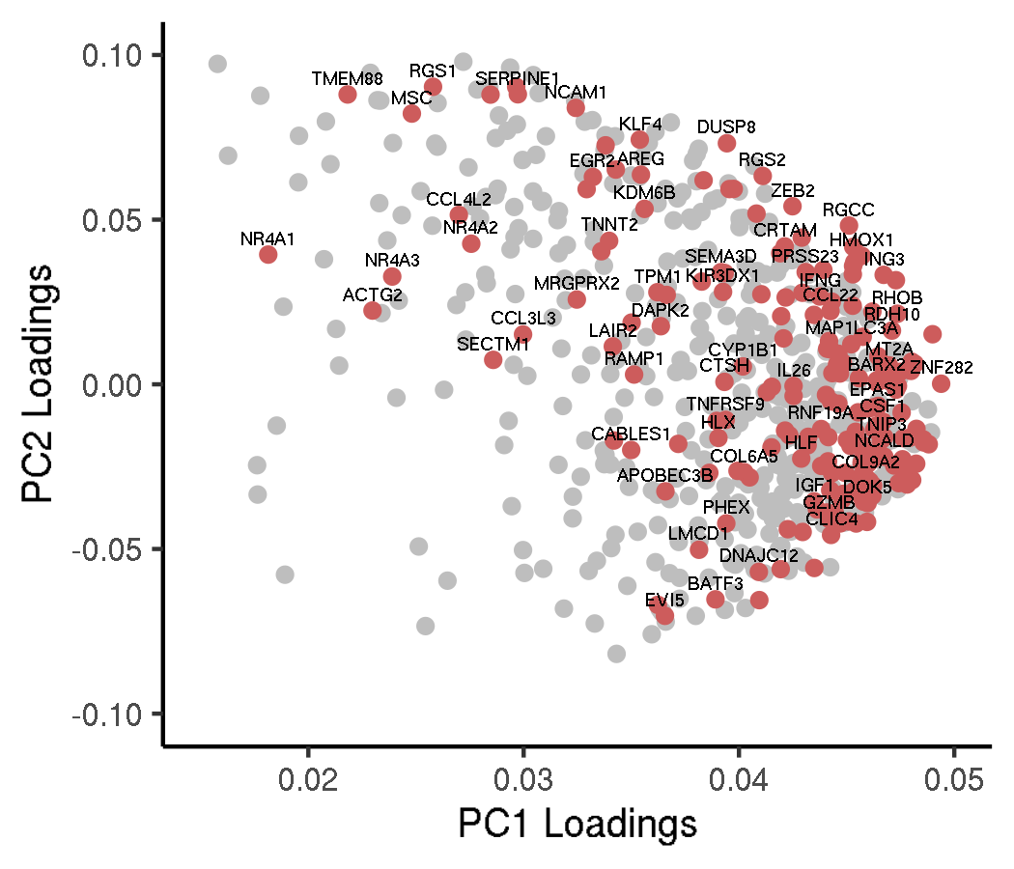
CARTEx project
Figure 1. Bulk RNA sequencing of sorted functional and exhausted CD8+ CAR T cells across 21 days
A
B
C
D
E
F
G

Slide 3
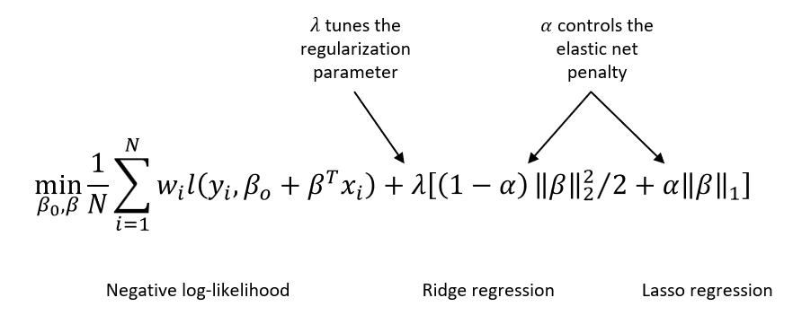
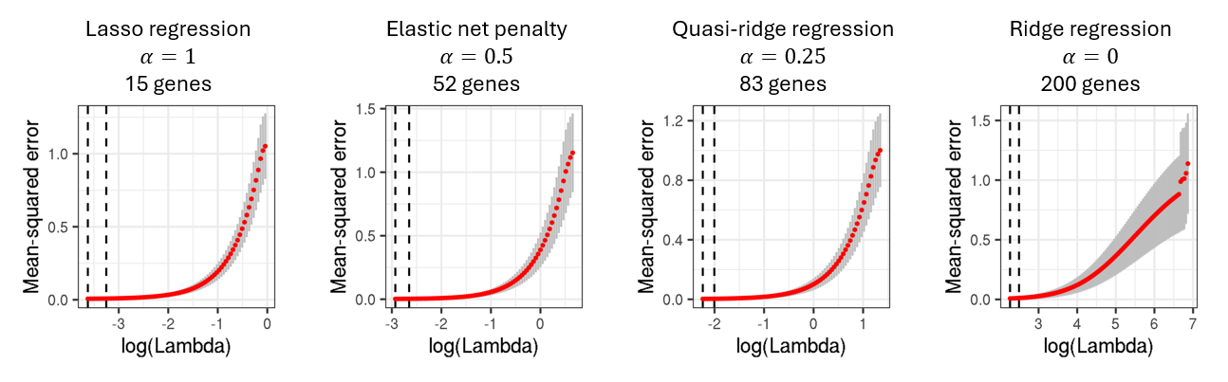
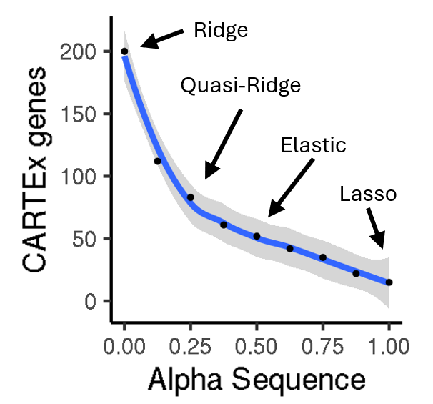
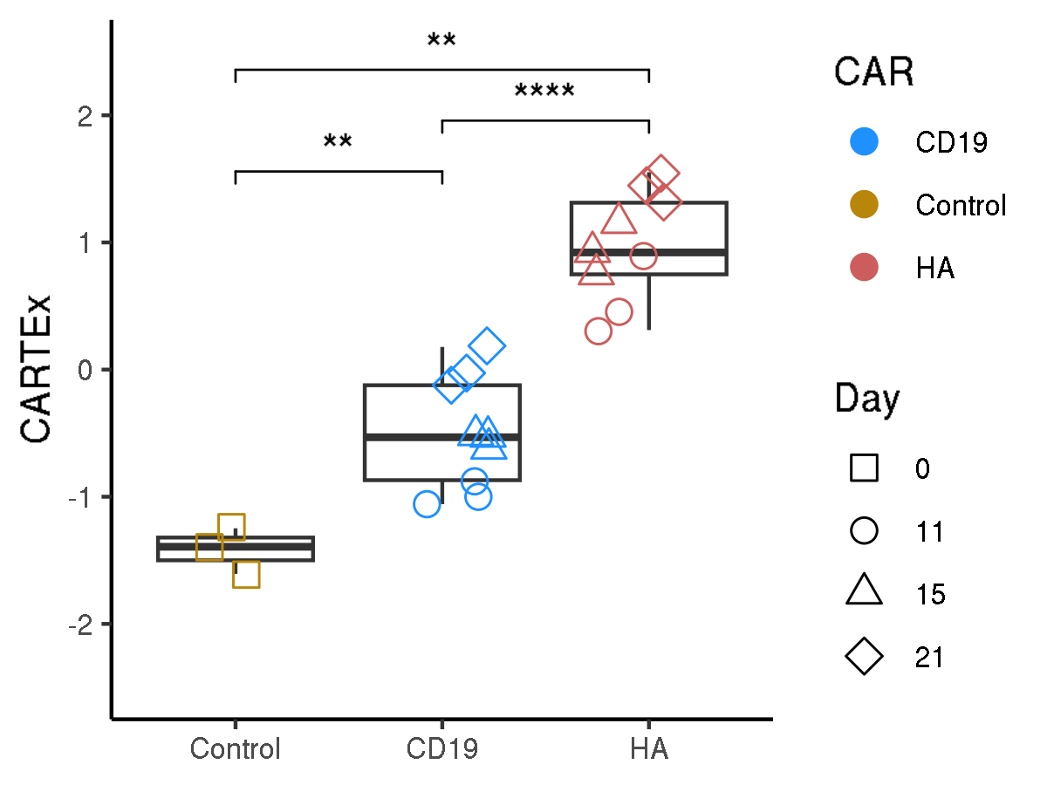
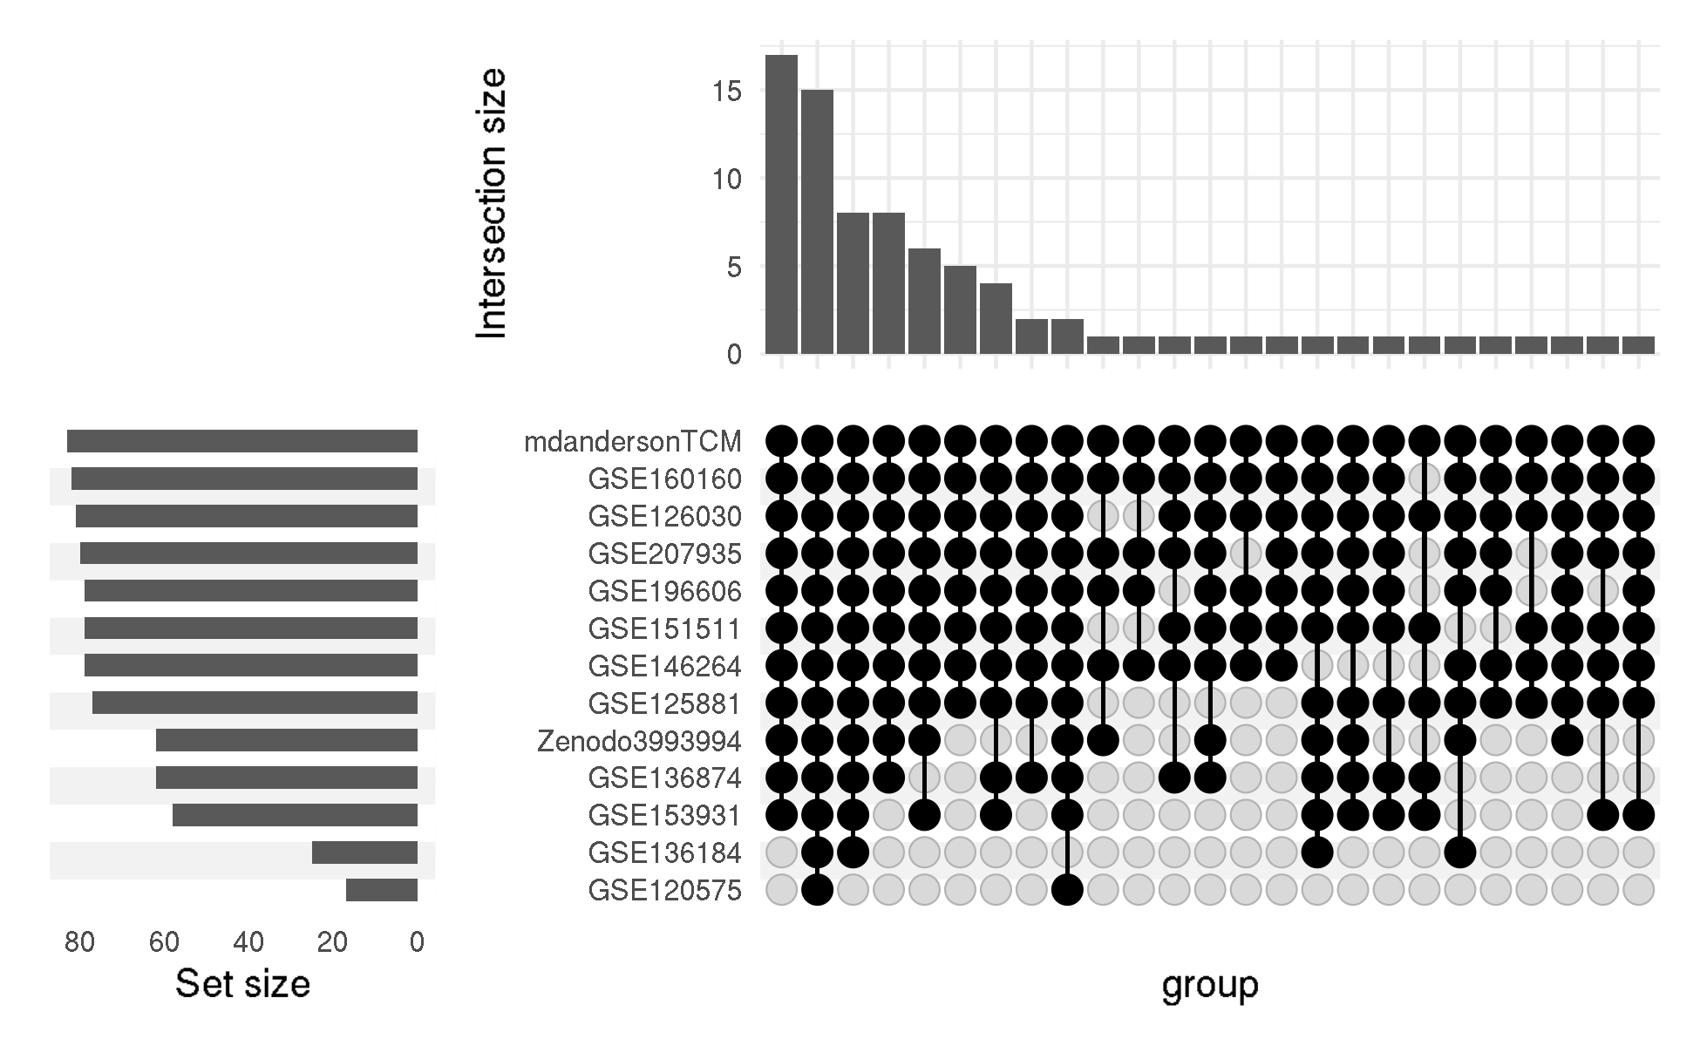
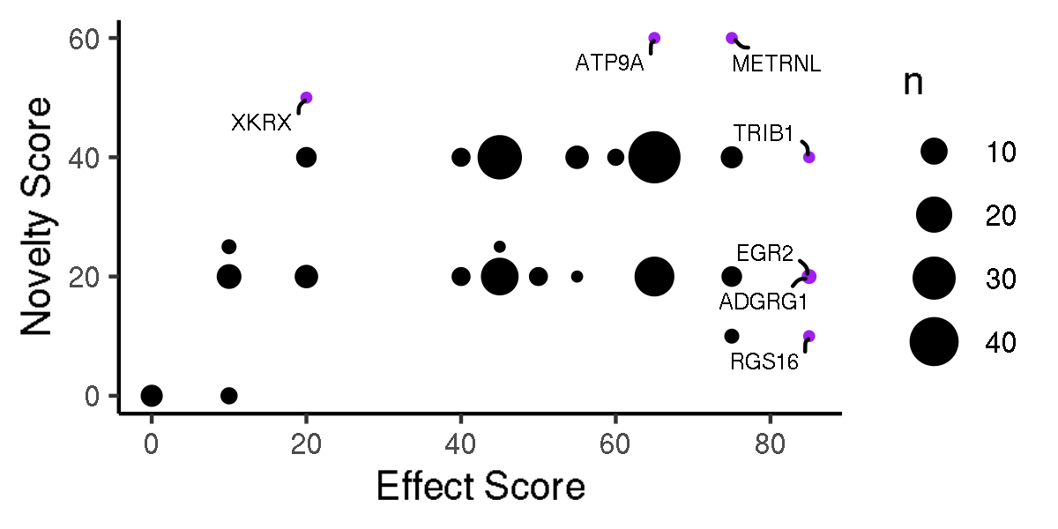
CARTEx project
Supplementary Figure 1. CARTEx signature refinement using glmnet
A
B
C
D
E

Slide 4
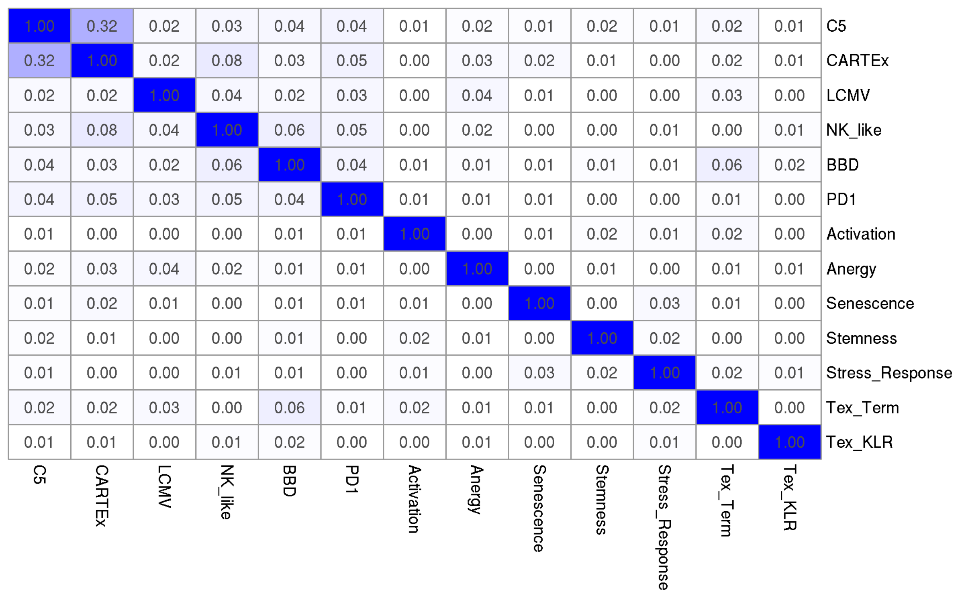
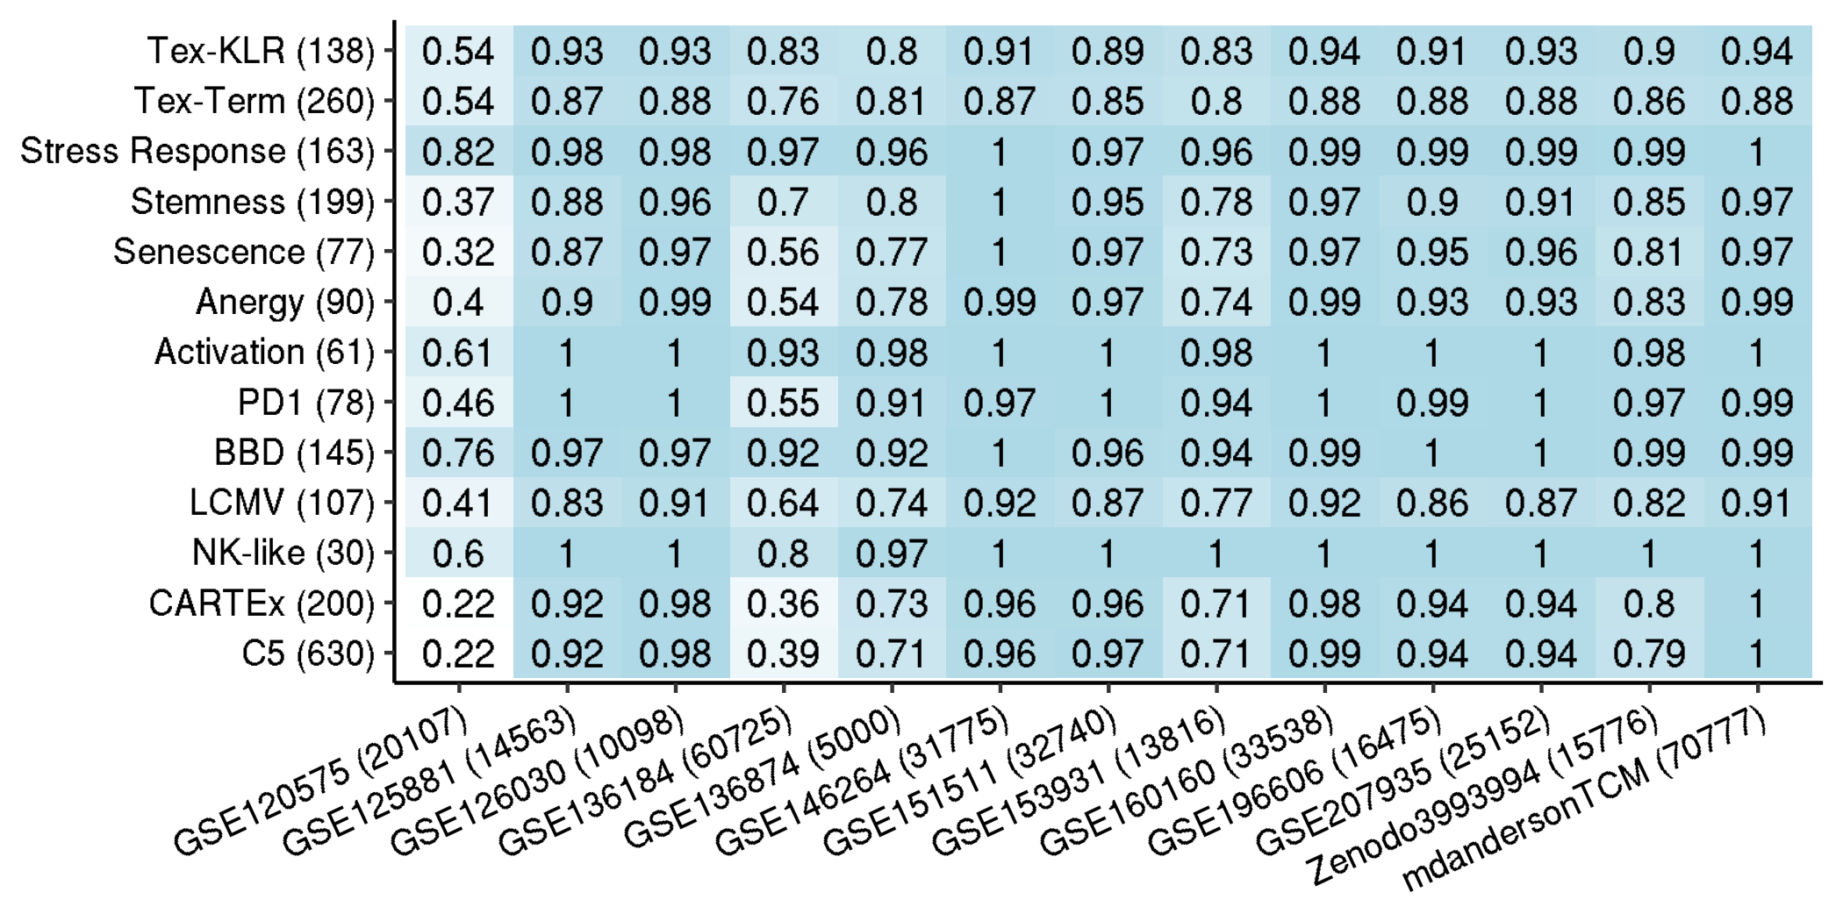
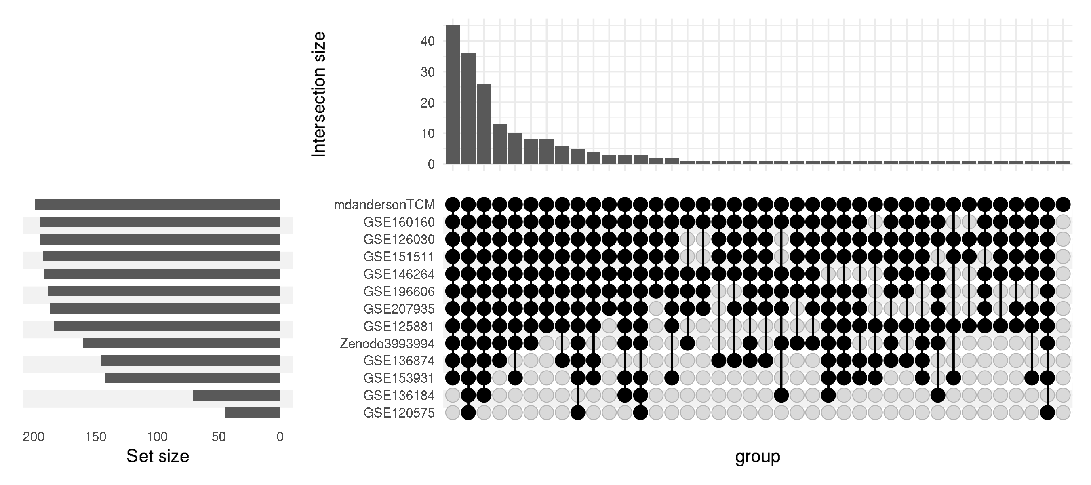
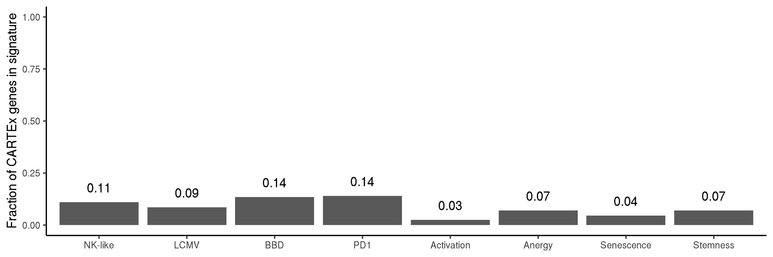
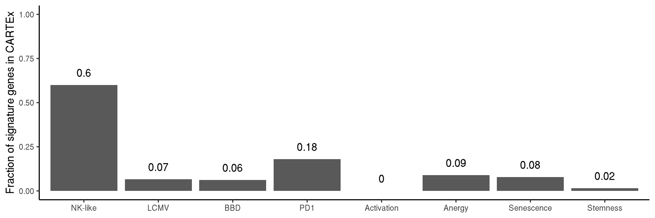
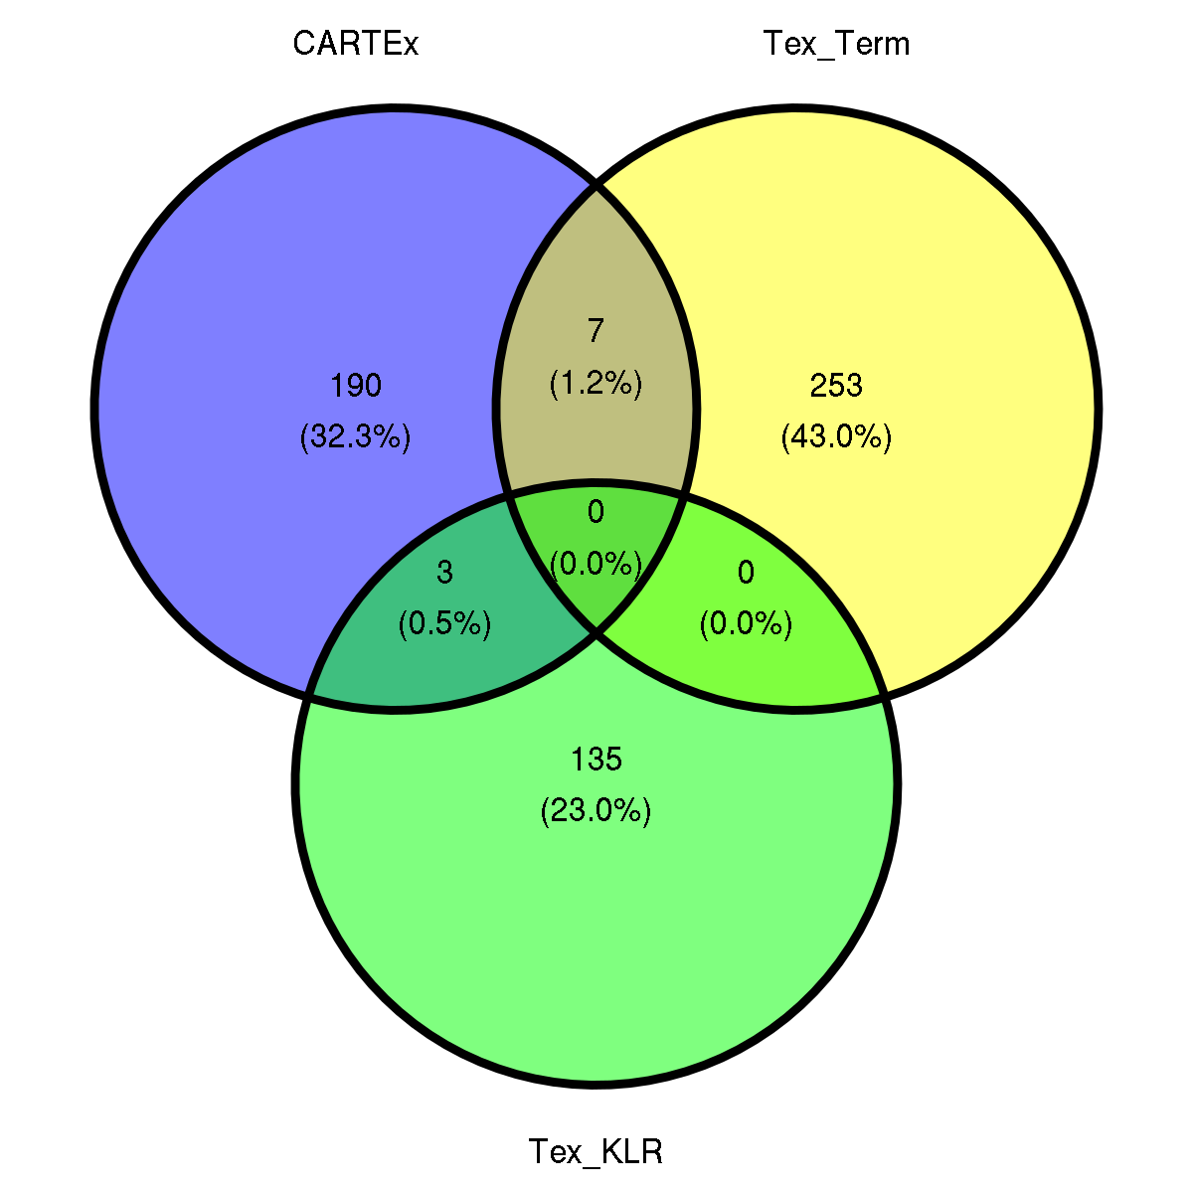
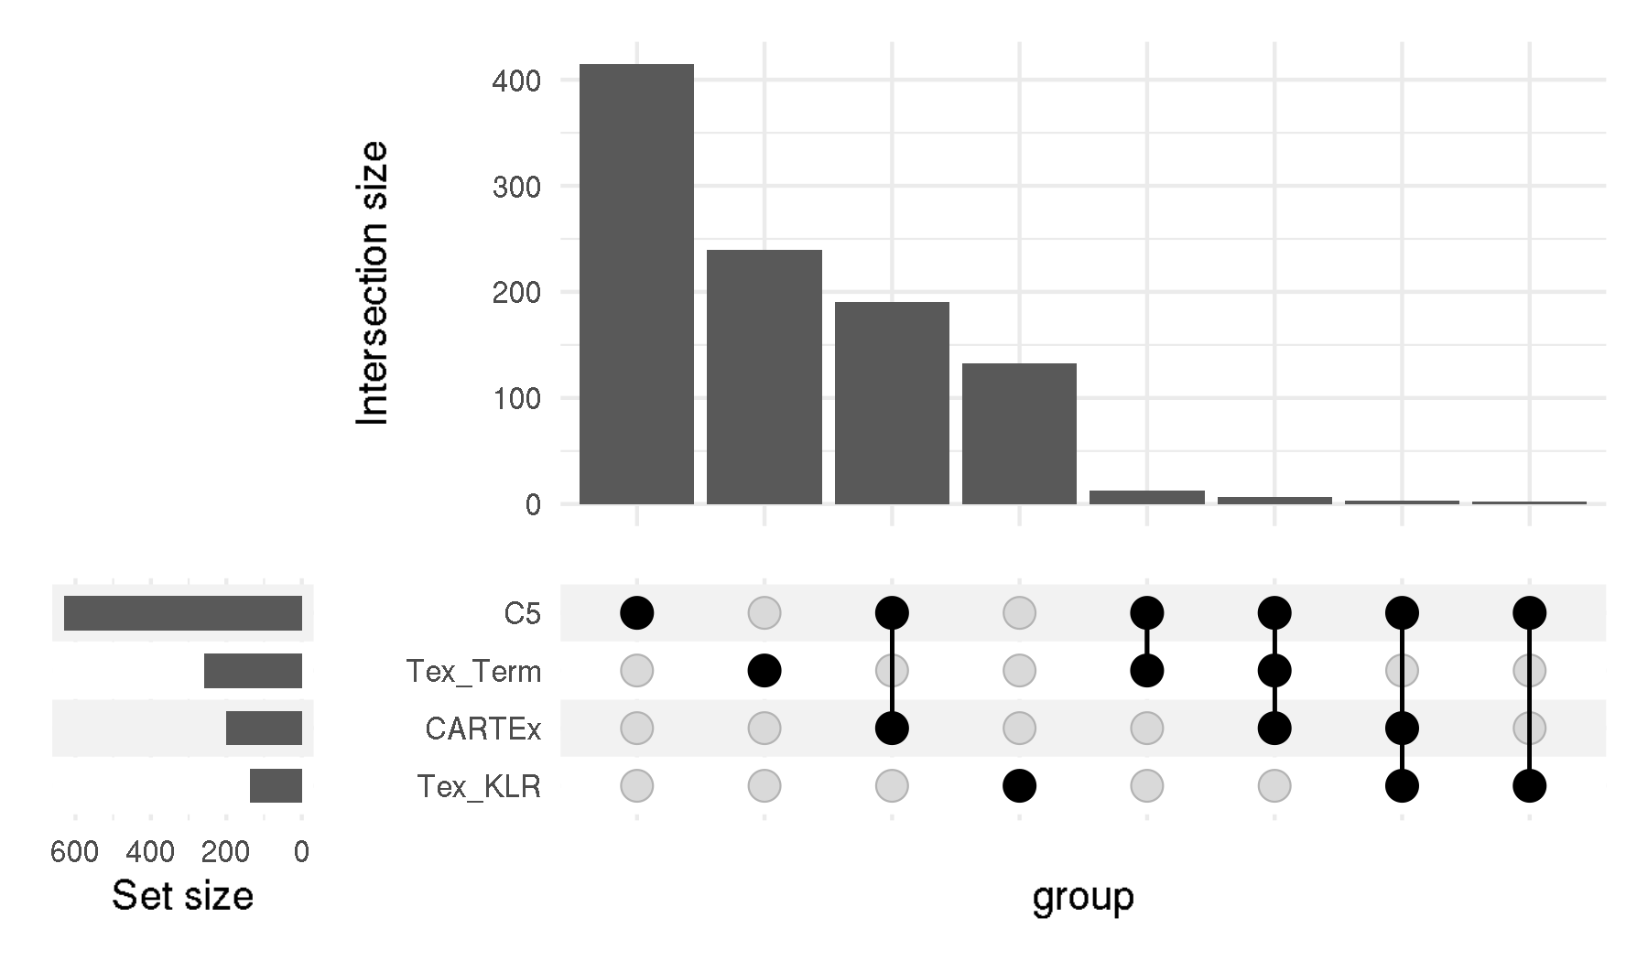
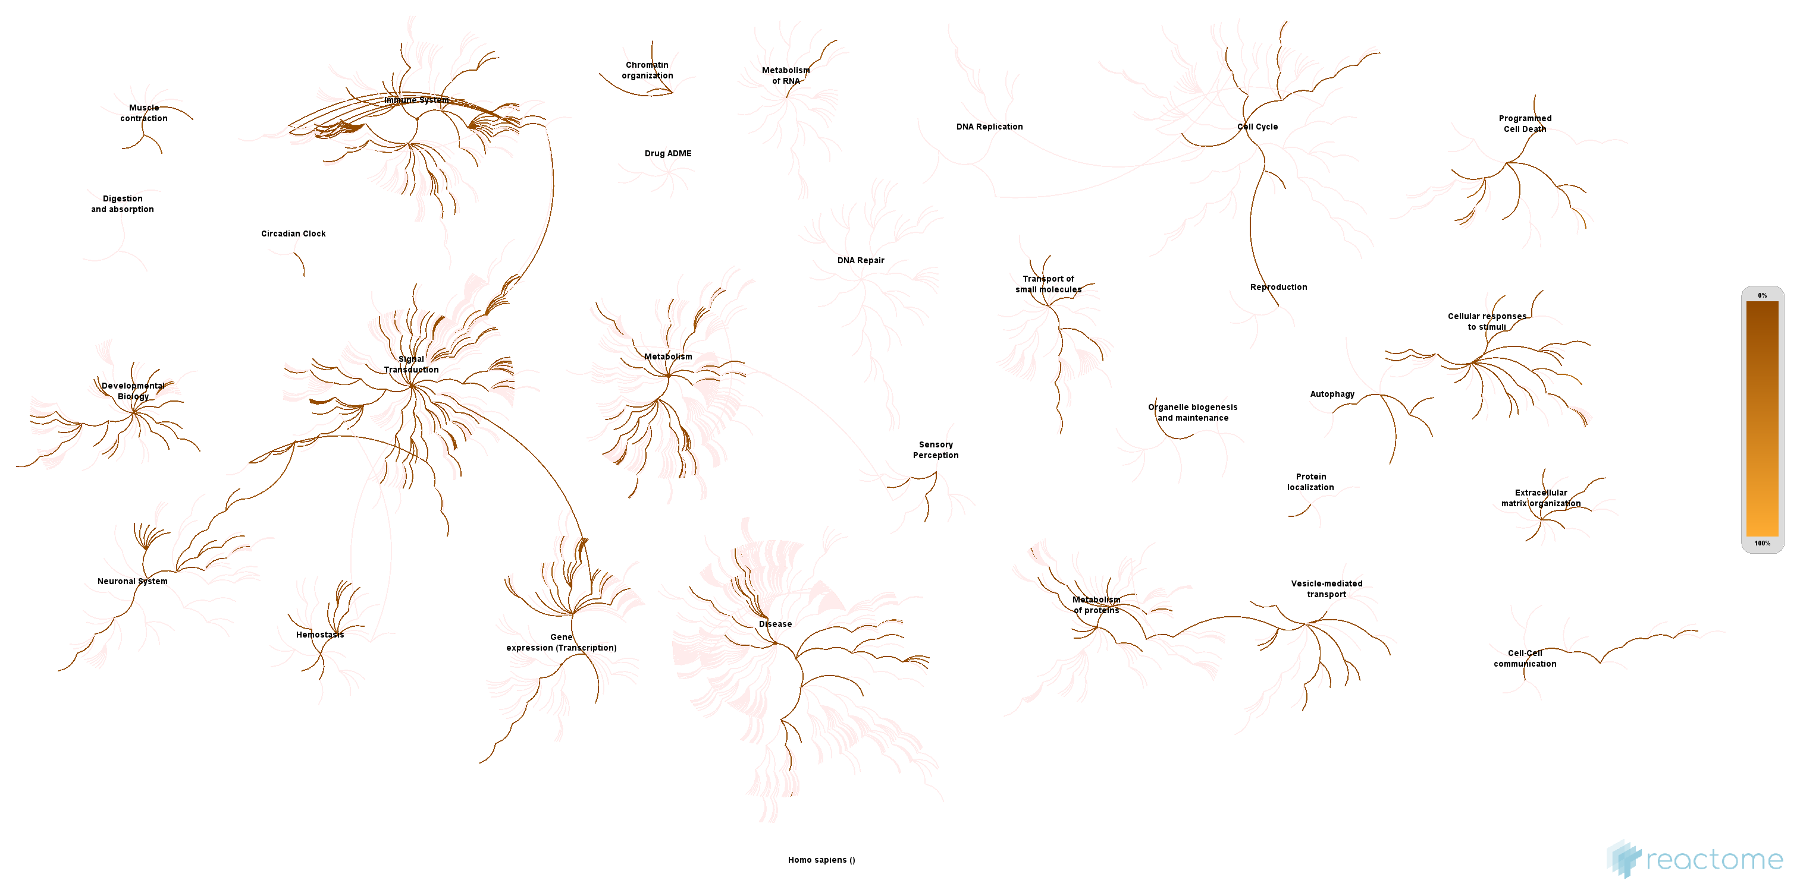
CARTEx project
Supplementary Figure 2. Signature representation
A
Jaccard index of signatures
B
Fraction of signature genes represented in experiments
C
D
E
F

Slide 5
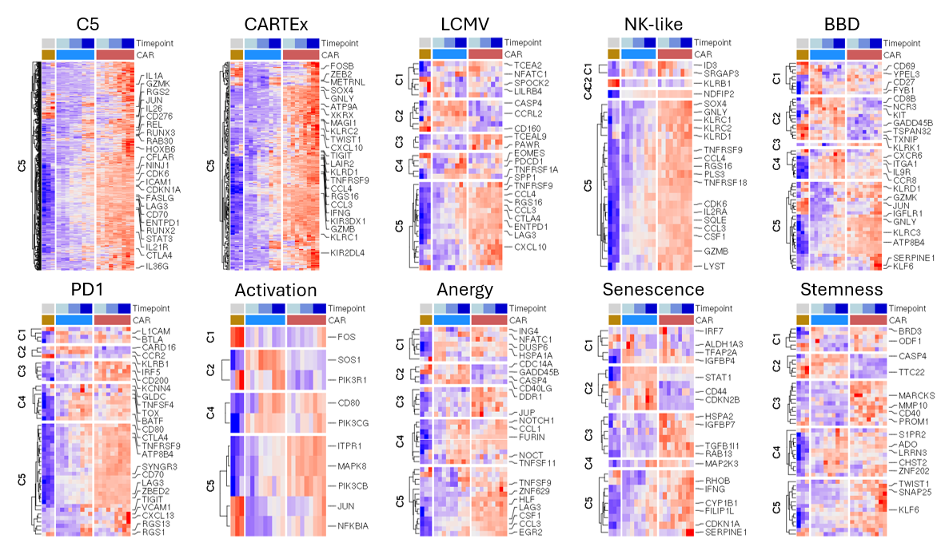
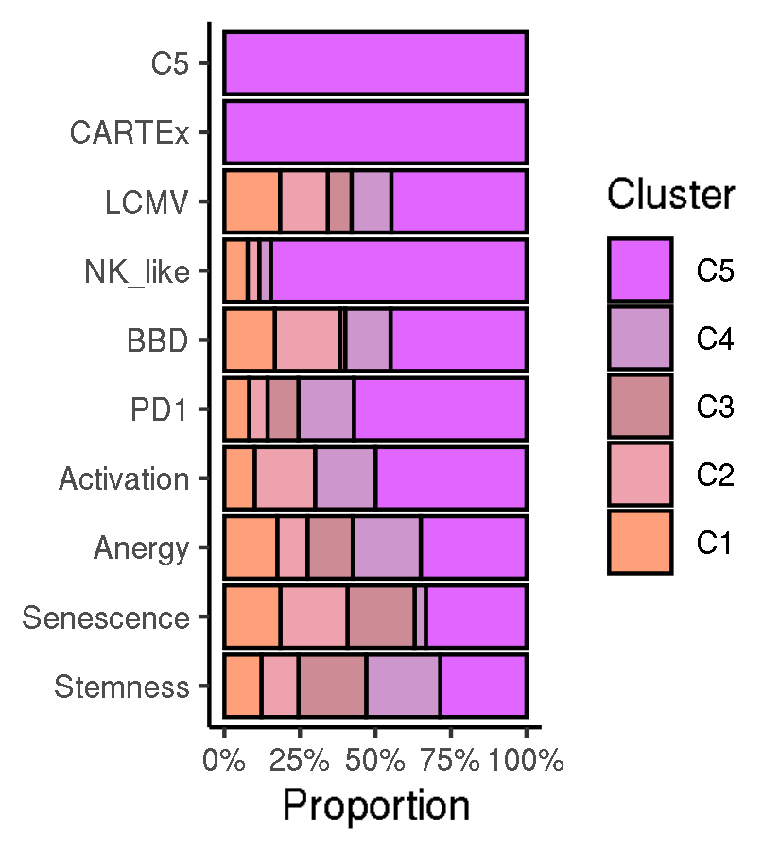
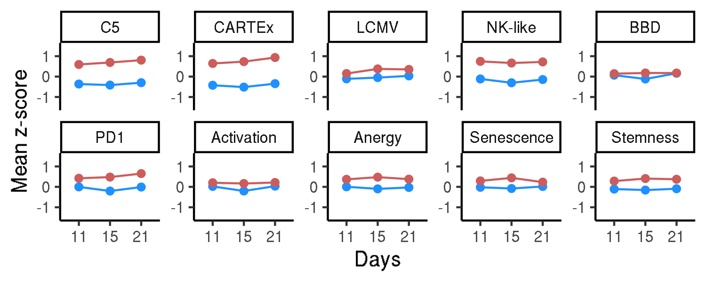
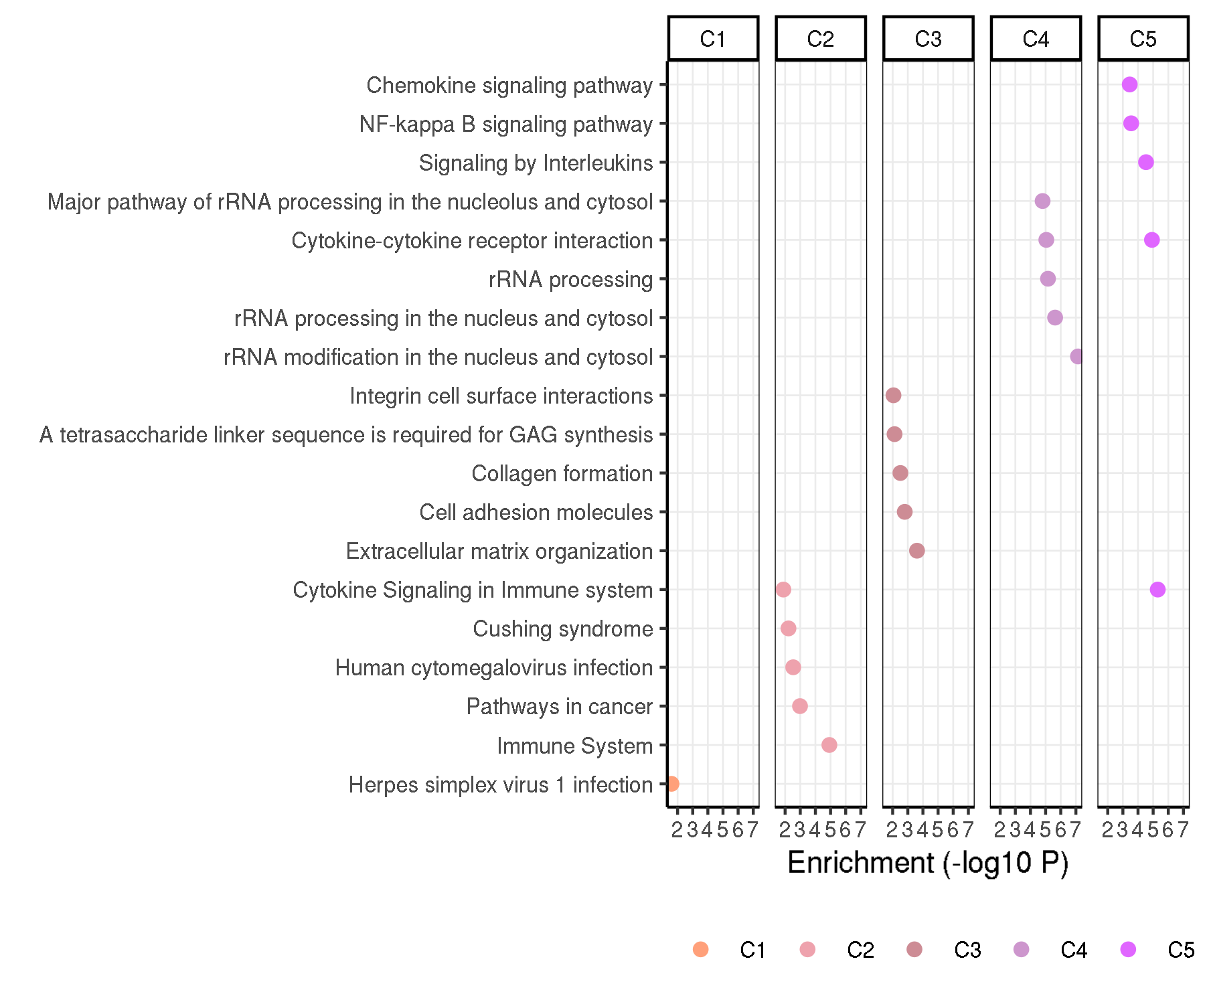
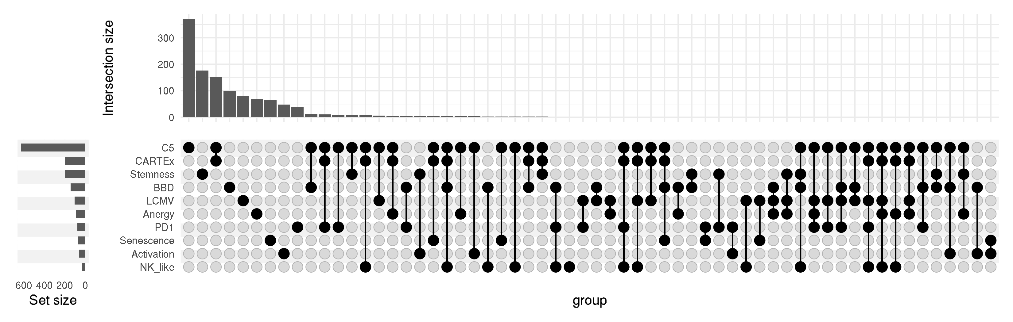
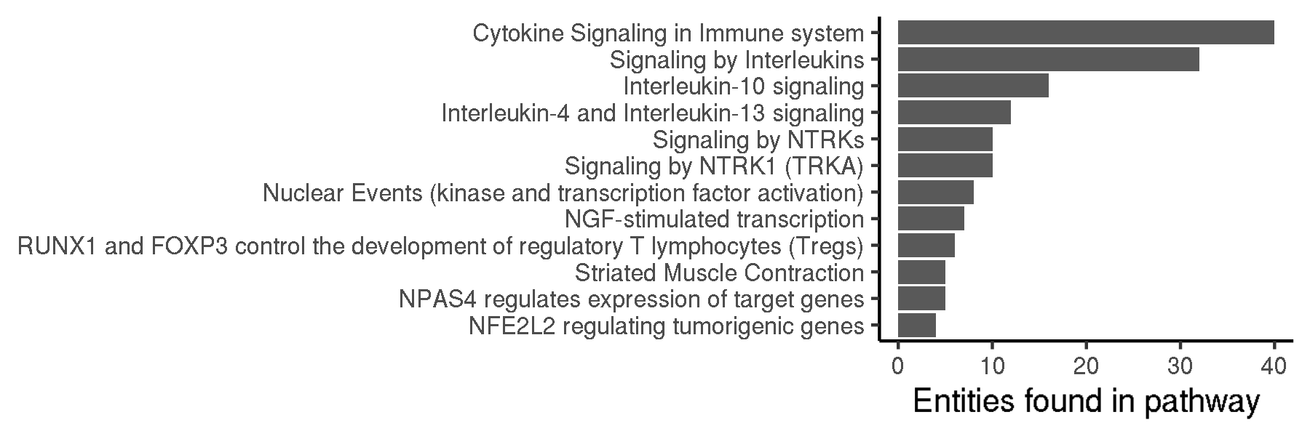
CARTEx project
Figure 2. Contextualizing the CARTEx signature
A
B
C
E
D
F

Slide 6
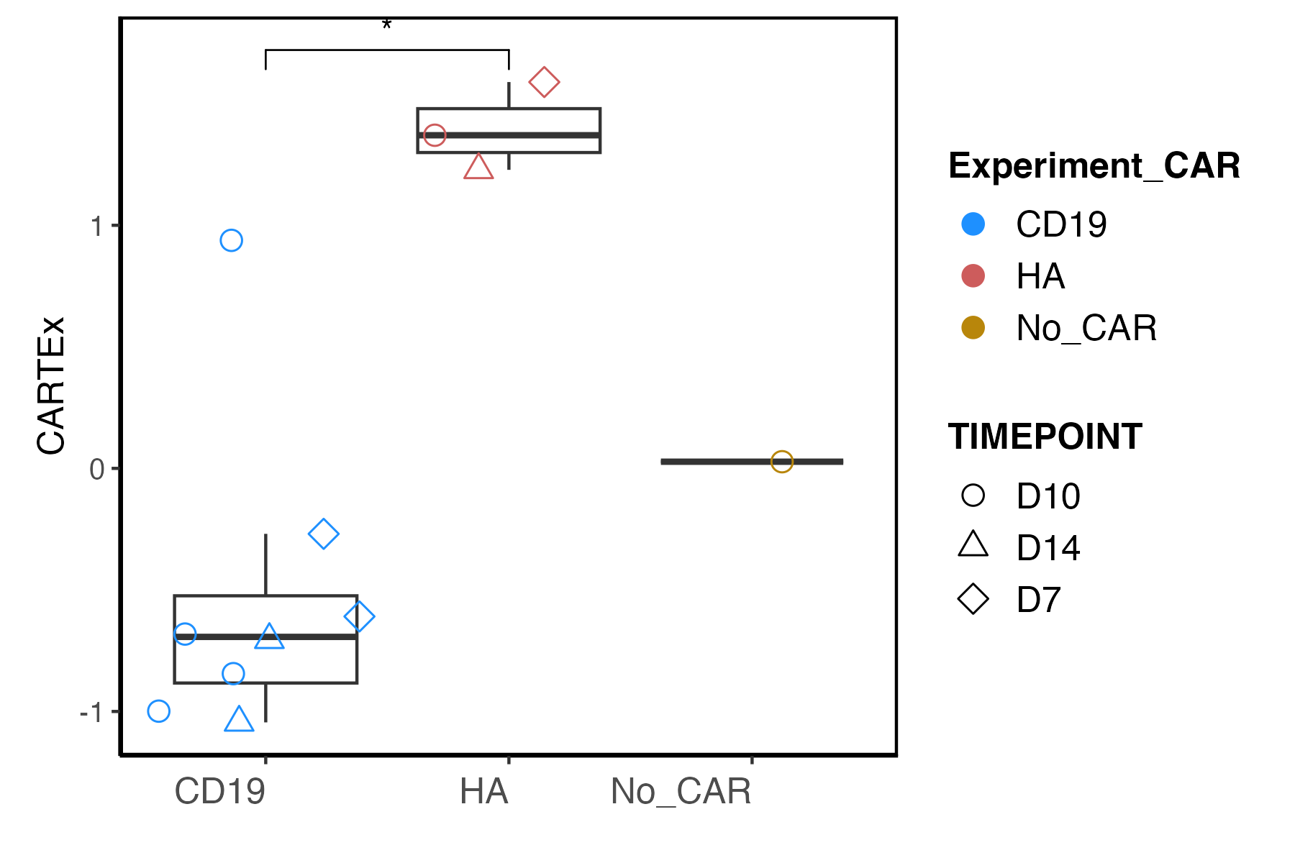
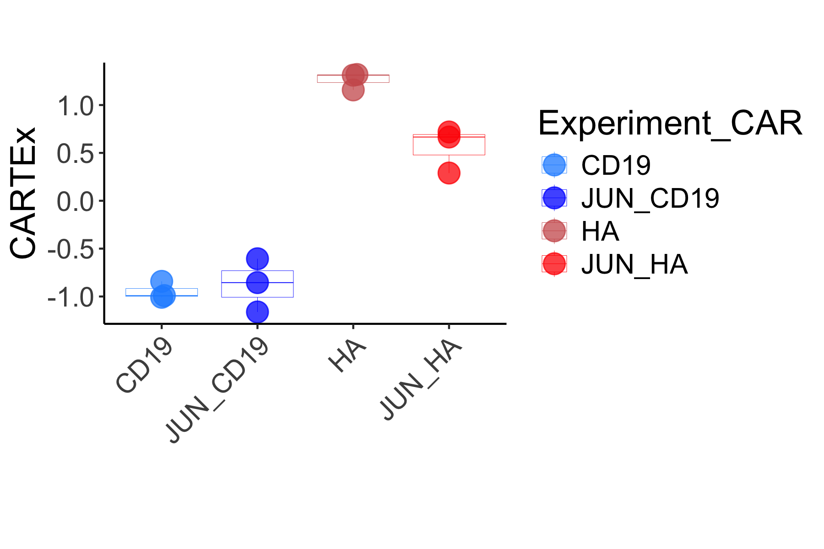
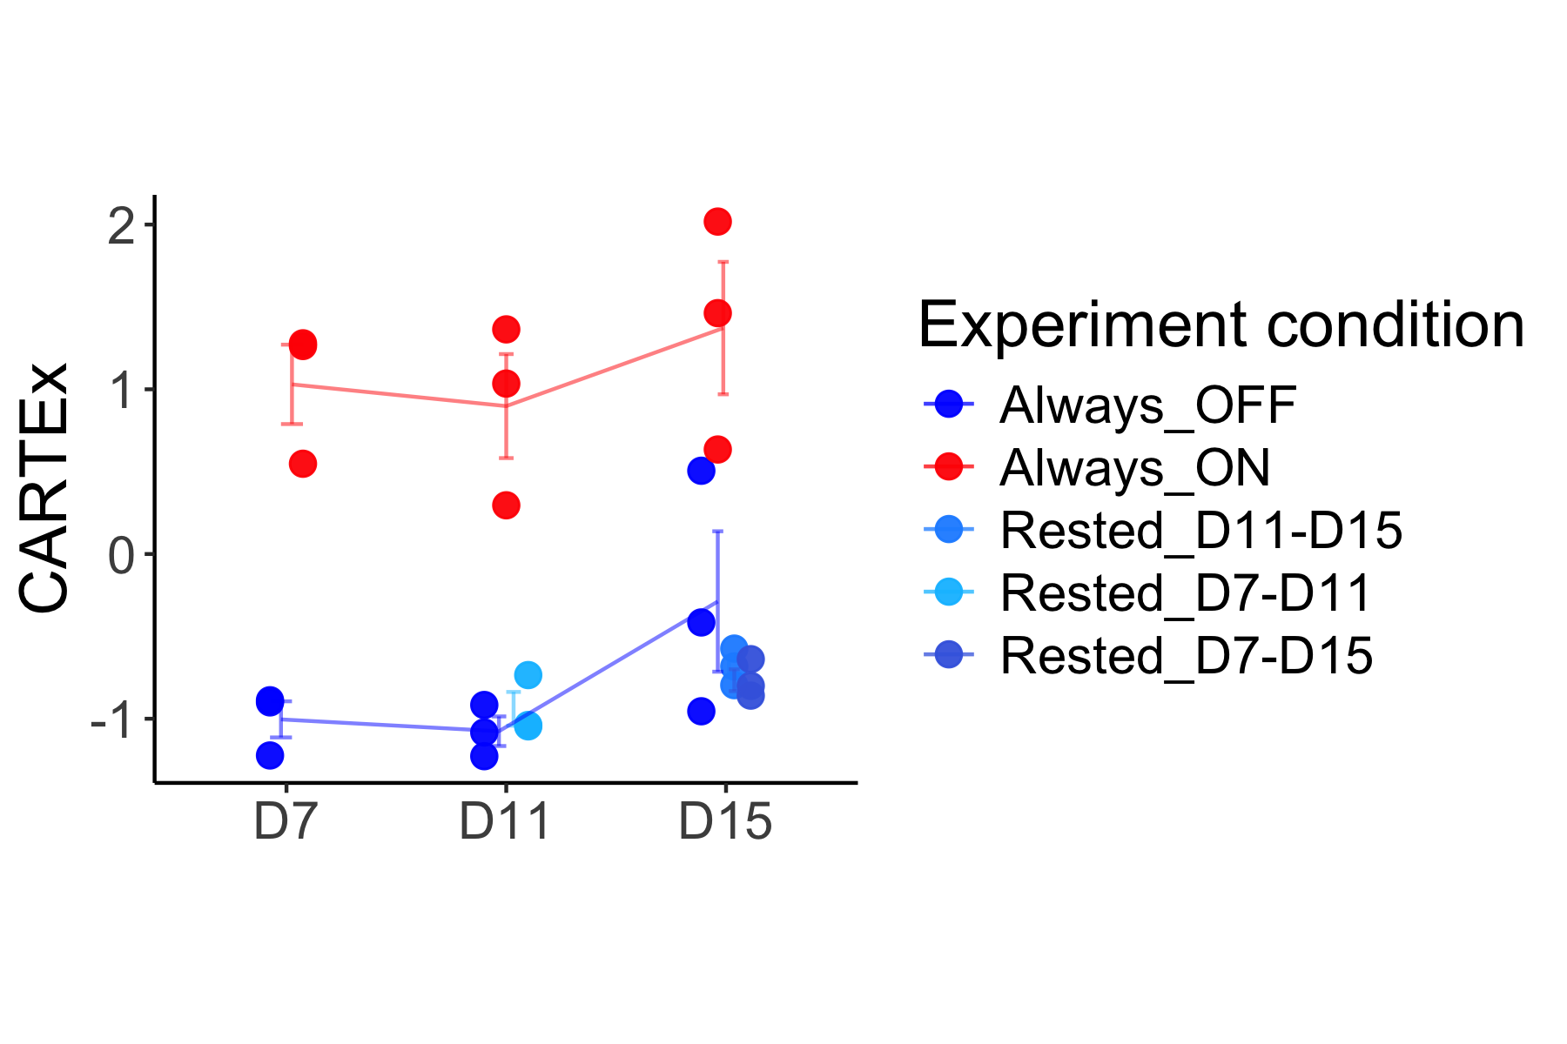
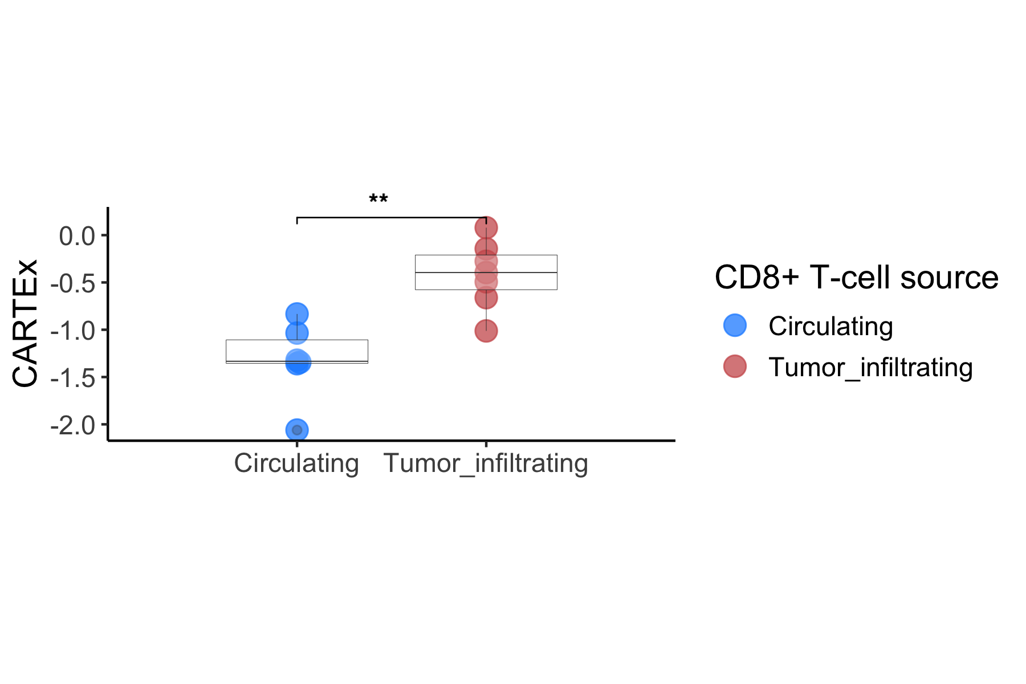
CARTEx project
Supplementary Figure 3. CARTEx scoring of bulk RNA sequencing datasets
A
B
C
D

Slide 7
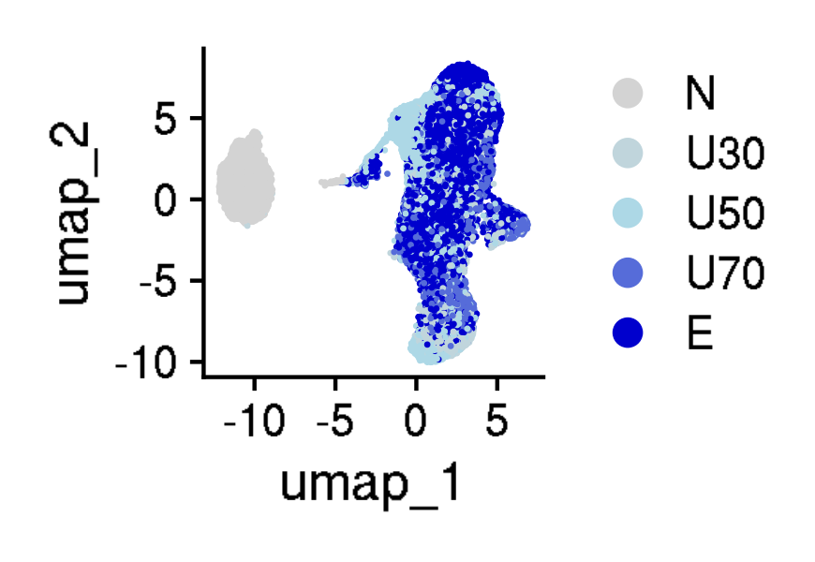
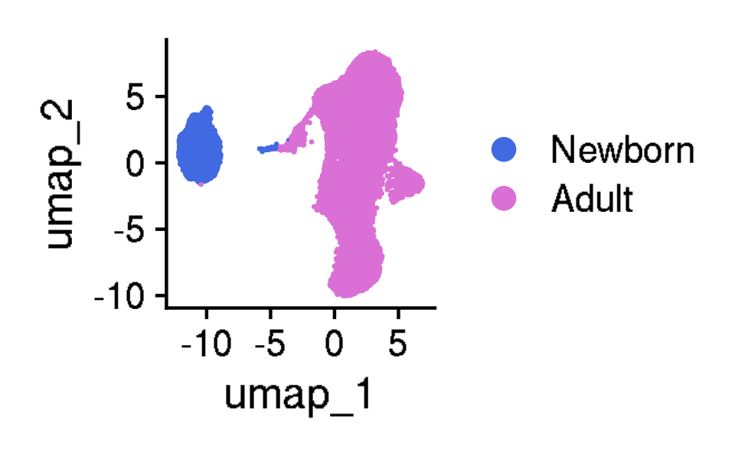
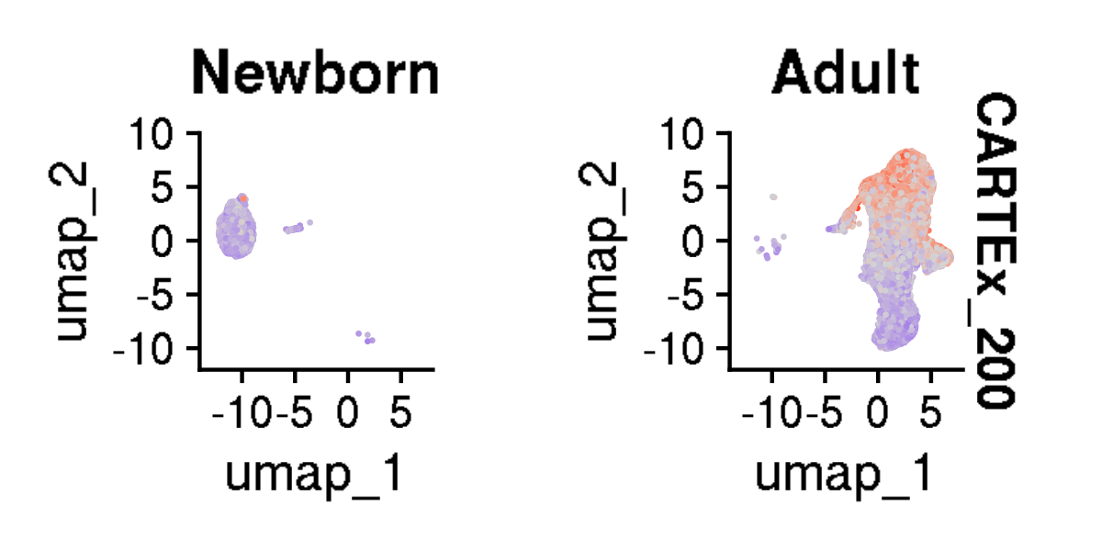
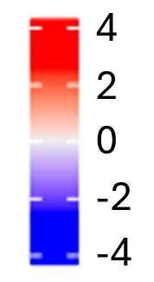
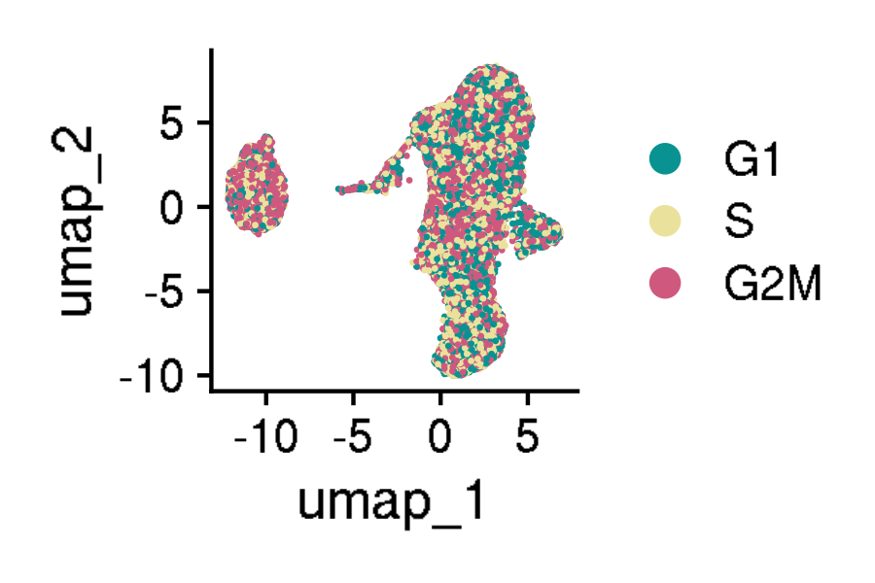
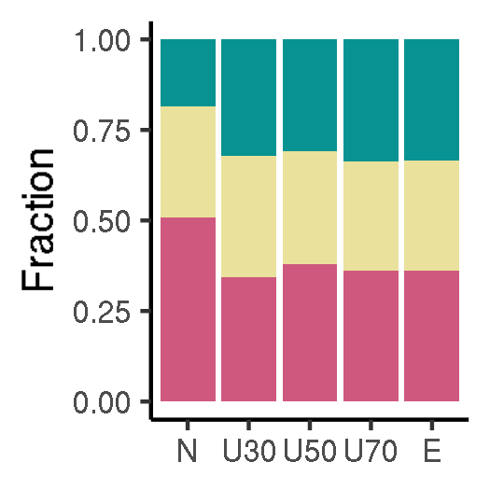
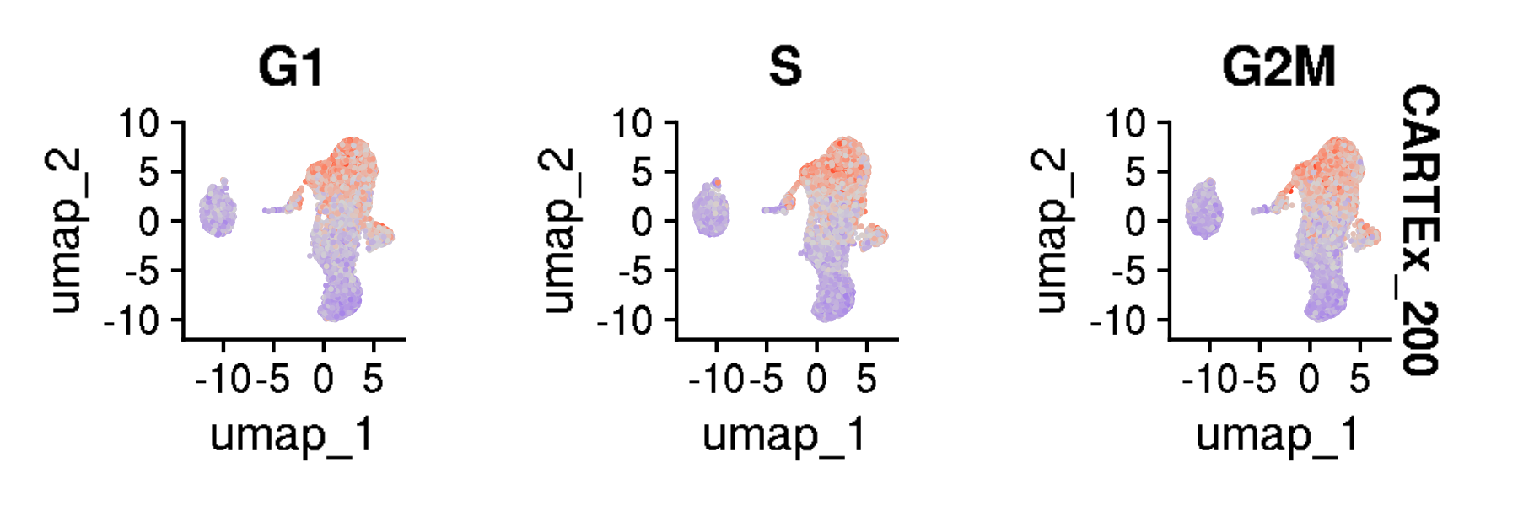
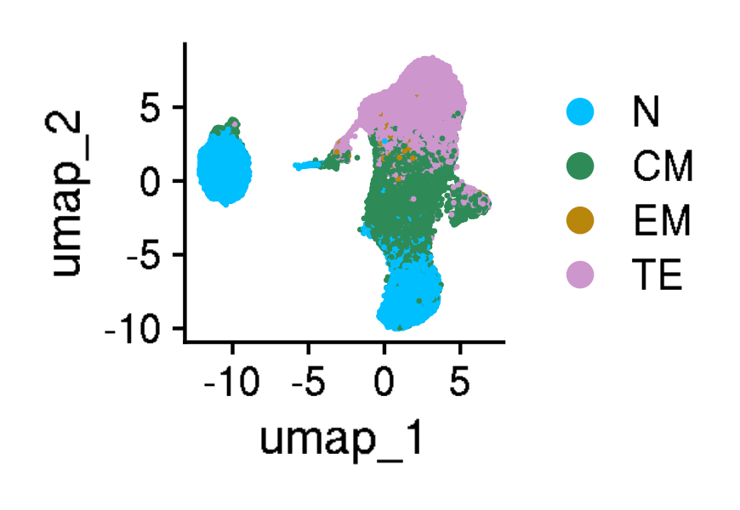
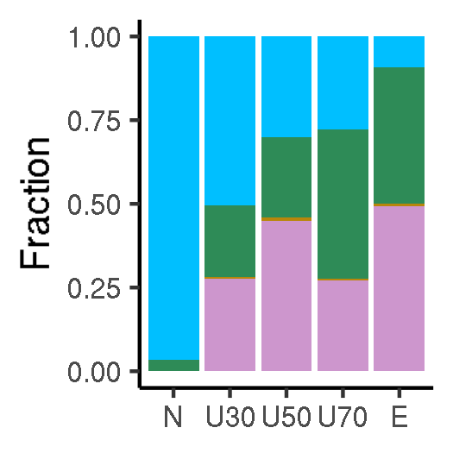
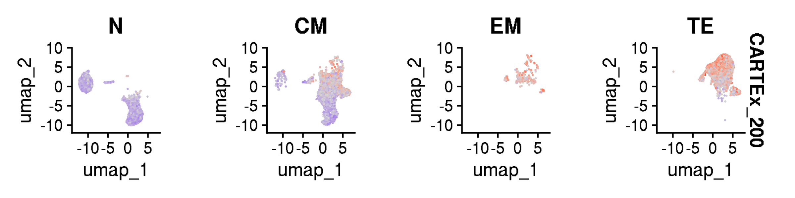
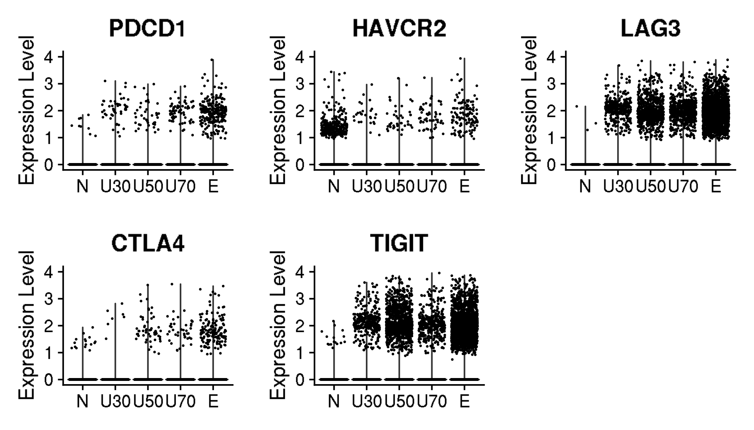
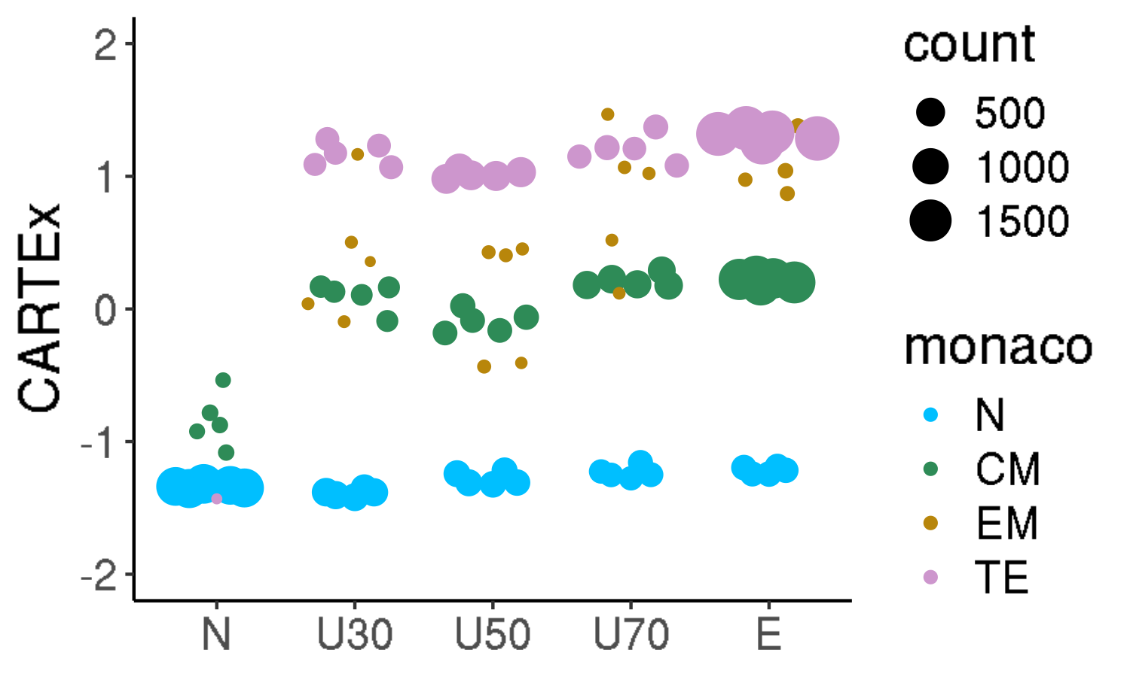
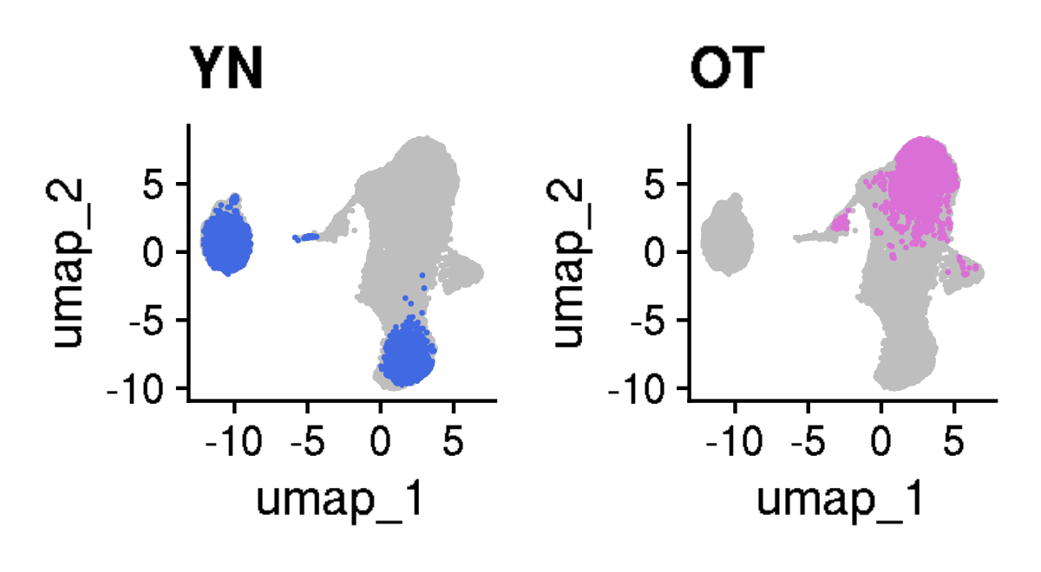
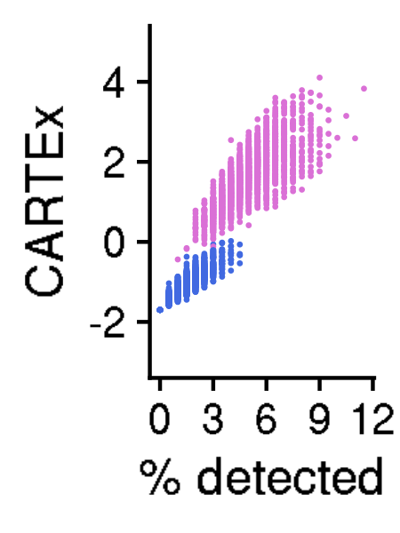
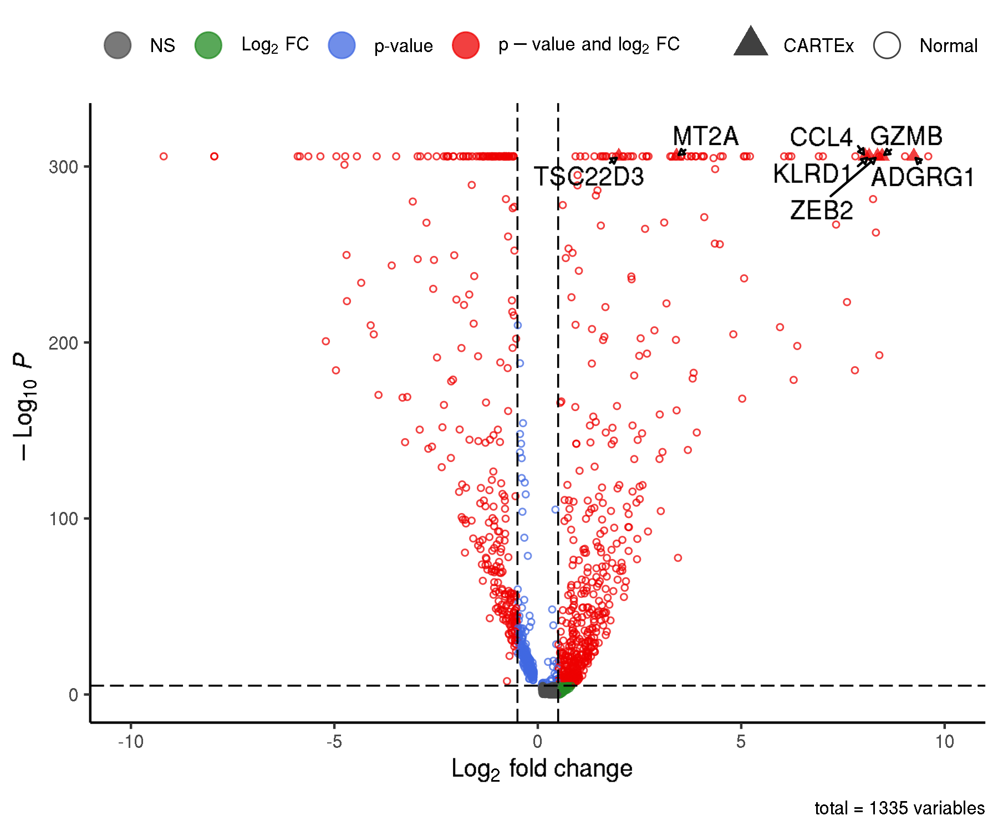
CARTEx project
Figure 3. Analysis of 39,937 CD8+ T cells from healthy donors across 9 decades of life
A
B
C
D
E
F
G
H
I
J
K

Slide 8




























CARTEx project
Figure 4. Analysis of 14,436 functional and exhaustion-prone CD8+ CAR T cells
A
B
C
D
E
F
G
H
I
J
K
L
M
N
O
P
Q
R
S
T
U
V

Slide 9
























CARTEx project
Supplementary Figure 4. Additional analysis of exhaustion-prone CAR T cell models
A
B

Slide 10














CARTEx project
Supplementary Figure 5. Analysis of 5,434 resting and stimulated CD8+ T from healthy donors
A
B
C
D
E
F
G
H
I
J
K
L

Slide 11













CARTEx project
Supplementary Figure 6. Analysis of 53,757 CD8+ T cells from 16 cancer types
A
B
C
D
E
F
G
H
I
J
K

Slide 12





























CARTEx project
Figure 5. Analysis of 101,626 CD8+ endogenous and CAR T cells in clinical oncology
A
B
C
D
E
F
G
H
I
J
K
L
M
N
O
P
Q
R
S
T

Slide 13













CARTEx project
Supplementary Figure 7. Analysis of 61,583 CD8+ virus-reactive T cells including those with memory response to SARS-CoV-2
A
B
C
D
E
F
G
H
I
J
K

Slide 14












CARTEx project
Figure 6. Analysis of 25,191 CD8+ T cells from patients with STAT3 GOF syndrome
A
B
C
D
E
F
G
H

Slide 15











CARTEx project
Supplementary Figure 8. Additional analysis of STAT3 GOF CD8+ T cells
A
B
C
D

Slide 16










CARTEx project
Supplementary Figure 9. Analysis of 3,342 CD8+ T cells from patients with severe psoriasis
A
B
C
D
E
F
G
H

Slide 17











CARTEx project
Supplementary Figure 10. Analysis of 8,118 CD8+ T cells from patients with BEACH domain deficiencies
A
B
C
D
E
F
G
H
I

Slide 18
















CARTEx project
Supplementary Figure 11. Analysis of 28,105 CD8+ T cells from patients with Parkinson's disease
A
B
C
D
E
F
G
H
I
J
M
K
L
N

Slide 19
CARTEx project
EXTRA SLIDES

Slide 20








CARTEx project
Supplementary Figures for aging dataset (this is longitudinal data)
A
B
A

Slide 21





CARTEx project
Supplementary Figures for aging dataset (head-to-head comparison with various signatures)

Slide 22






CARTEx project
Supplementary Figures for validation in exhaustion-prone models

Slide 23


CARTEx project
Supplementary Figures for validation in exhaustion-prone models

Slide 24





CARTEx project
Supplementary Figure for CARTEx applied to clinical oncology

Slide 25
























CARTEx project
Supplementary Figure for CARTEx applied to clinical oncology

Slide 26












CARTEx project
Supplementary Figure for CARTEx applied to clinical COVID-19

Slide 27














CARTEx project
Supplementary Figure. More STAT3 GOF (diffusion maps)

Slide 28
CARTEx project
Supplementary Figure 2. Signature representation
A
B
C
D

Slide 29

CARTEx project
Supplementary Figure 2. continued
F

